Slide 1
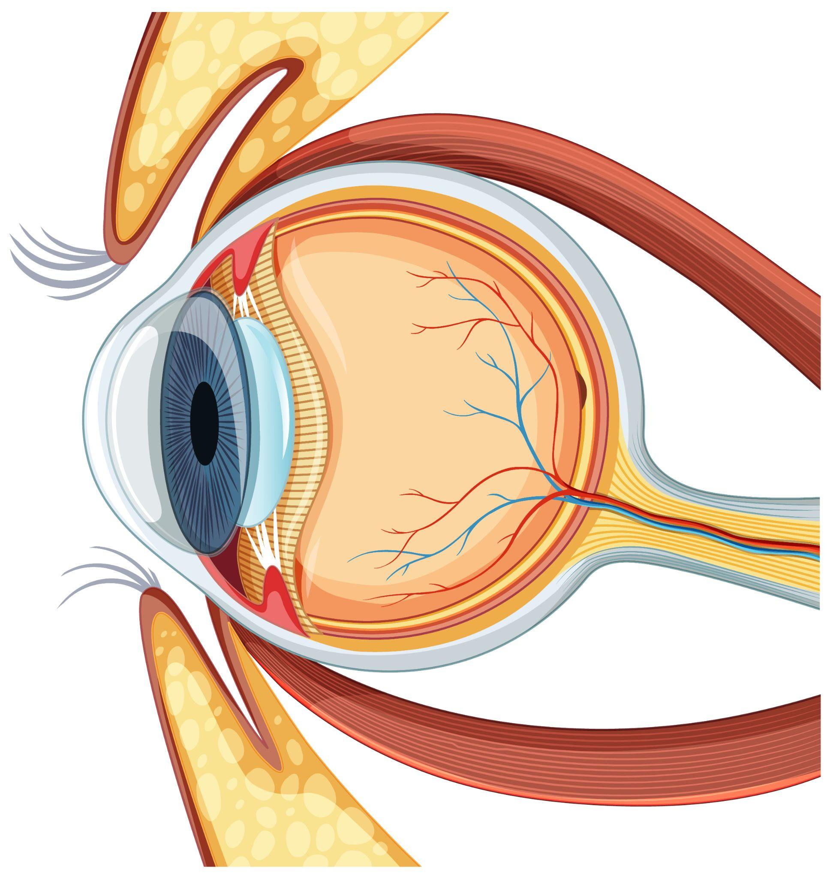
Diabetic Retinopathy Grading Using Deep Neural Networks
Institute of Electrical and Electronics Engineering
Master’s Final Year project defense
Option: Computer Engineering
Presented by:
Amira TEMMAM
Chaima AHMED GAID
Supervisor:
Prof. Abdelhamid DAAMOUCHE
Co-supervisor:
Dr. Abbas CHEDDAD

Slide 2
OUTLINE
01
02
03
04
PROBLEM
SOLUTION
APPROACH
EXPERIMENTS
Diabetic Retinopathy
Deep Learning & Transfer Learning
Techniques Used
Results & Discussion

Slide 3
400 Million
People with diabetes
Notes:
One-third of people living with diabetes have some degree of diabetic retinopathy, and every person who has diabetes is at risk of developing it.

Slide 4
Diabetic Retinopathy
Diabetes Mellitus is a global health concern with millions affected and projected to reach 700 million cases by 2045.
Diabetic Retinopathy (DR) is a common complication of diabetes that can lead to blindness, but early detection and treatment can reduce the risk.
Notes:
One-third of people living with diabetes have some degree of diabetic retinopathy, and every person who has diabetes is at risk of developing it.

Slide 5
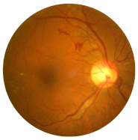
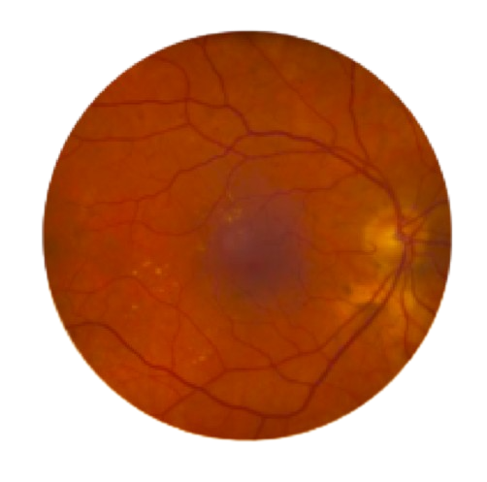
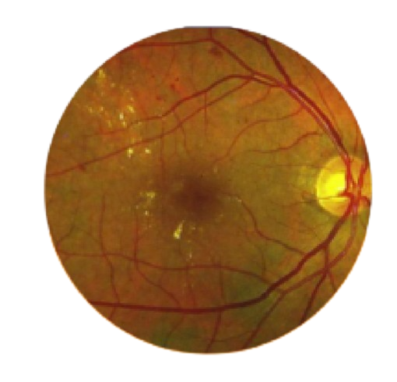
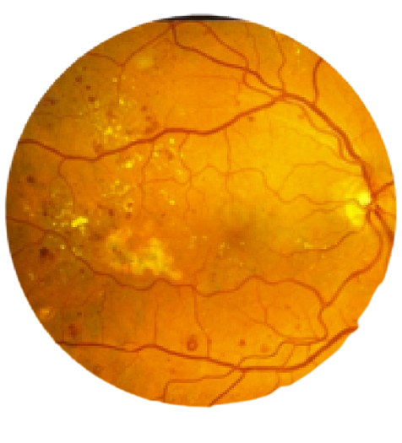
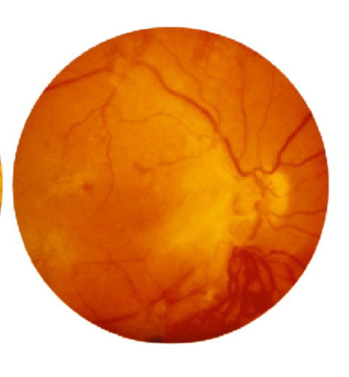
Stages of Diabetic Retinopathy
Severe
Sharp decline in retinal blood flow and the development of new blood vessels
Moderate
Retinal blood vessel blockages
Mild
Minute swellings in the retinal blood vessels
No DR
Healthy eye
Proliferate DR
Growth of new, flimsy blood vessels that are prone to fluid leakage in the retina.

Slide 6

Diabetic Retinopathy Challenges
Digital fundus images are used for screening and assessing DR, but challenges exist in terms of affordability and accurate diagnosis.
Distinct characteristics of each stage of diabetic retinopathy pose challenges for accurate diagnoses by physicians.
Highly skilled clinicians may struggle to accurately assess the stages of diabetic retinopathy through manual evaluation.
Notes:
Ophthalmologists can identify the presence of DR by examining digital retinal fundus images, but this is a time-consuming and manual-intensive process. Thus, it is important to develop an automatic method to assist DR diagnosis

Slide 7
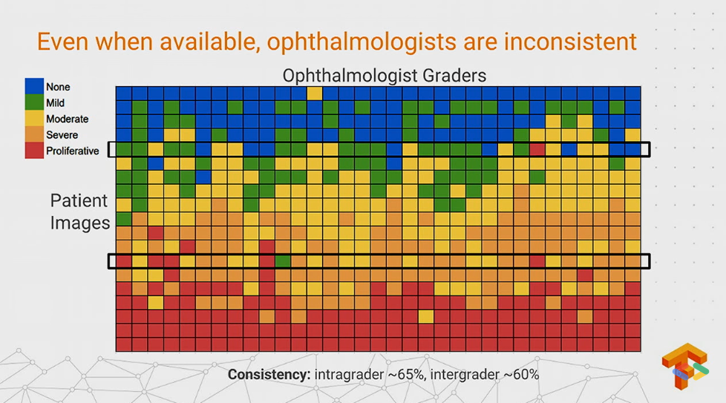
Notes:
Ophthalmologists can identify the presence of DR by examining digital retinal fundus images, but this is a time-consuming and manual-intensive process. Thus, it is important to develop an automatic method to assist DR diagnosis

Slide 8

Solution
Leveraging Artificial Intelligence (AI) and Deep Learning (DL) for the automation of DR detection and classification.
Convolutional Neural Networks (CNNs) have shown promise in automating the analysis of retinal fundus images for DR detection
Notes:
CNNs excel at capturing intricate features and spatial relationships in images, making them well-suited for tasks like diabetic retinopathy detection.

Slide 9
Classification Algorithms
The ability of machines to simulate human behaviour and take decisions intelligently like a human
Artificial Intelligence
The ability of machines to automatically learn without being explicitly programmed
Machine learning
Creates ANNs, which are capable of learning and taking decisions intelligently with the help of algorithms
Deep learning
Notes:
Artificial Intelligence (AI) is a field of computer science that aims to develop intelligent systems capable of performing tasks that typically require human intelligence.
Machine Learning, a subset of AI, focuses on creating algorithms that enable machines to learn from data and make predictions without explicit programming.
Deep Learning, a subfield of machine learning, employs neural networks with multiple layers to learn complex representations of data.

Slide 10
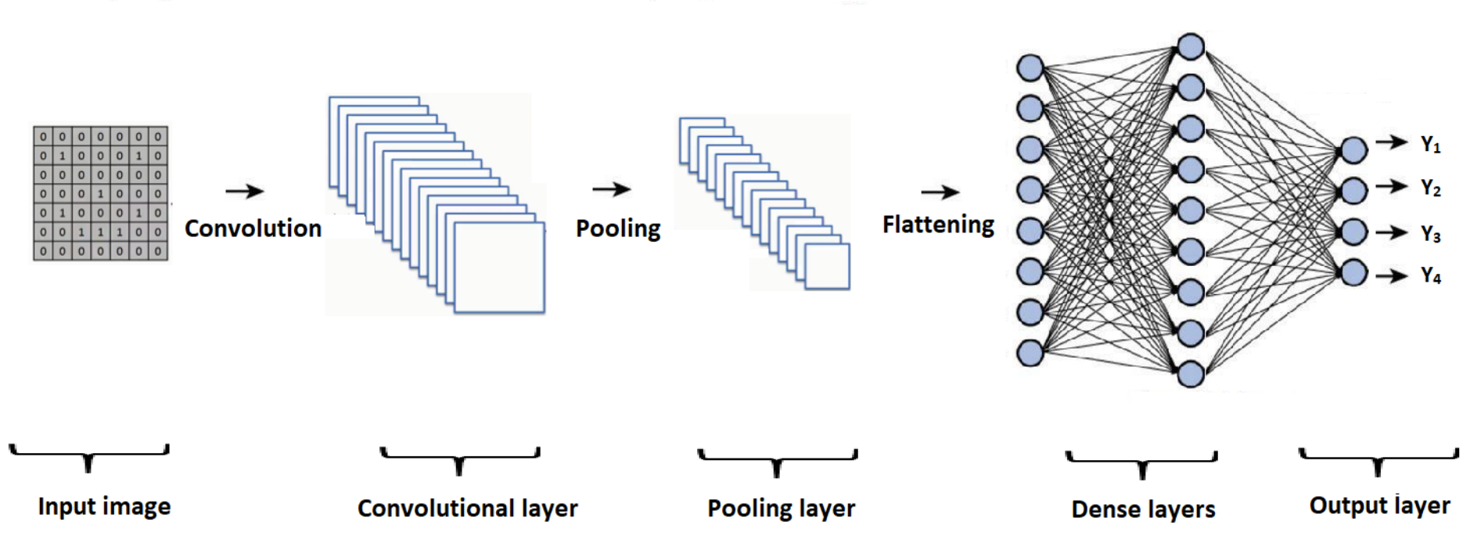
Convolutional Neural Networks

Slide 11
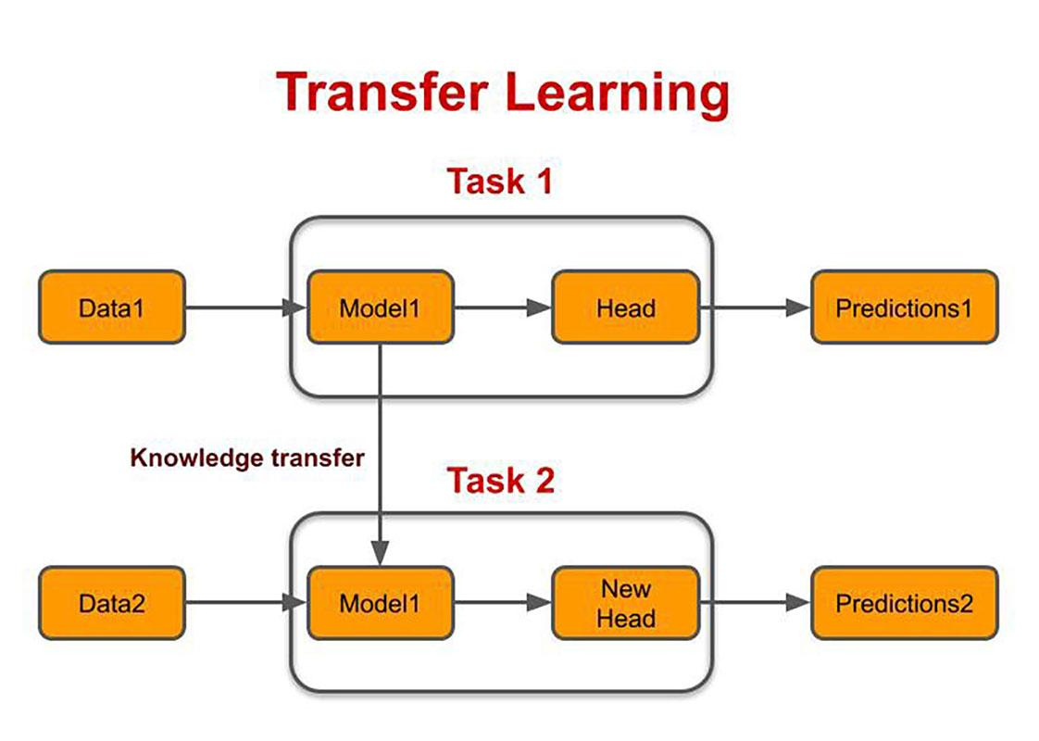
Transfer Learning
Transfer learning is a technique where knowledge learned from one task or dataset is applied to a different but related task
It leverages pre-trained models that have learned rich representations from large-scale datasets, such as ImageNet.
Transfer learning is beneficial for limited data, as it allows models to benefit from prior knowledge.
Notes:
It leverages pre-trained models that have learned rich representations from large-scale datasets, such as ImageNet.
Transfer learning is beneficial in scenarios with limited data, as it allows models to benefit from prior knowledge and generalize better to new tasks.

Slide 12




Workflow
DATASET
PREPROCESSING
AUGMENTATION
CLASSIFICATION

Slide 13
Datasets
They are publicly available Kaggle datasets that contain retinal fundus images, graded on a scale of 0 to 4, representing five stages of severity.
EyePACS
APTOS
DDR
35,126
California (USA)
3362
India
12,522
China

Slide 14
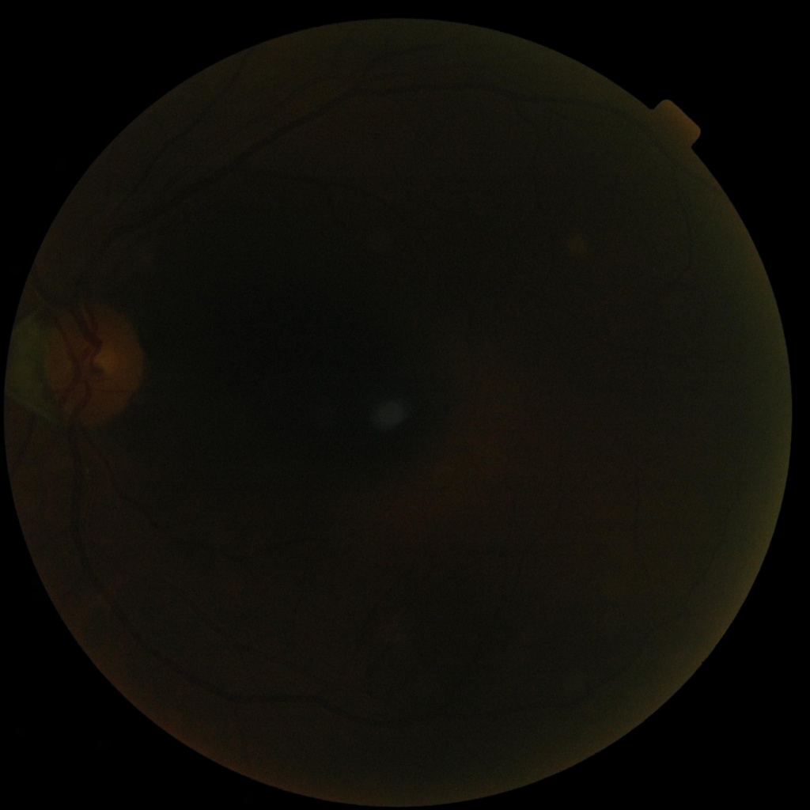
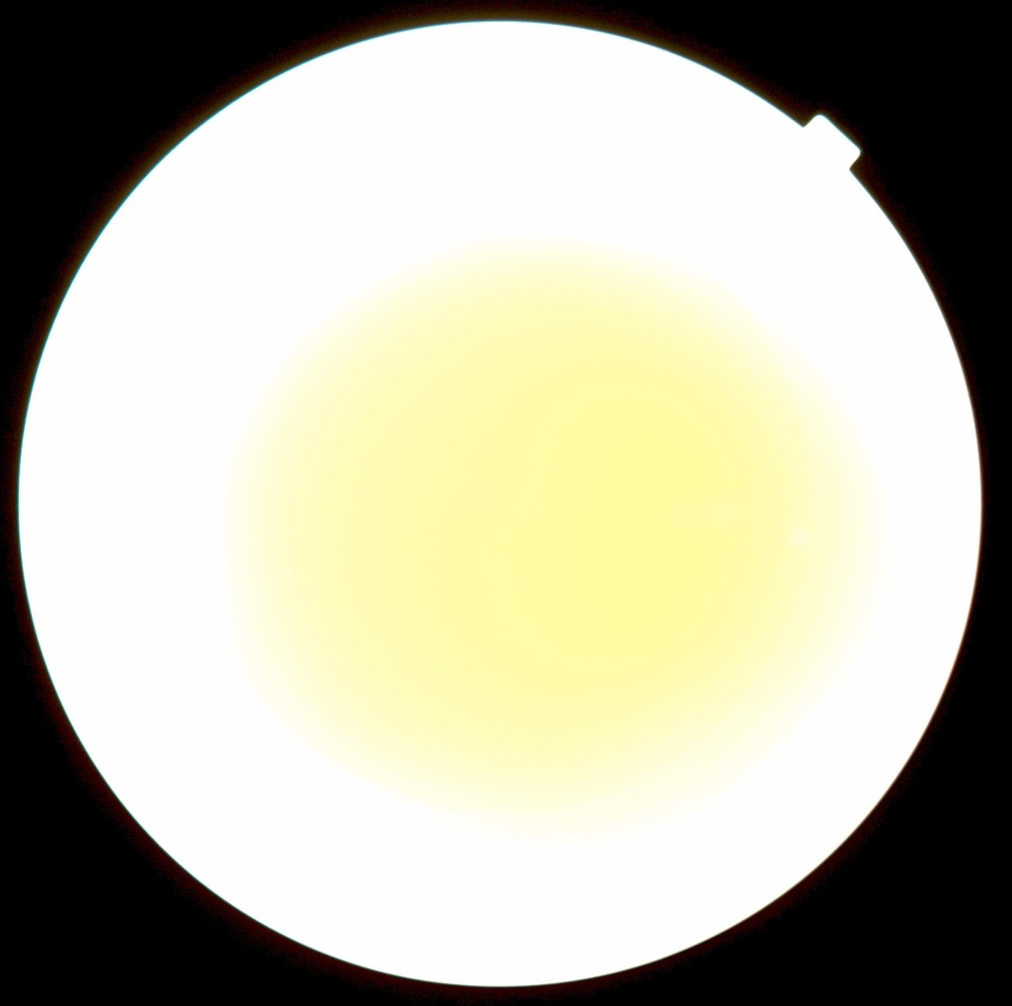
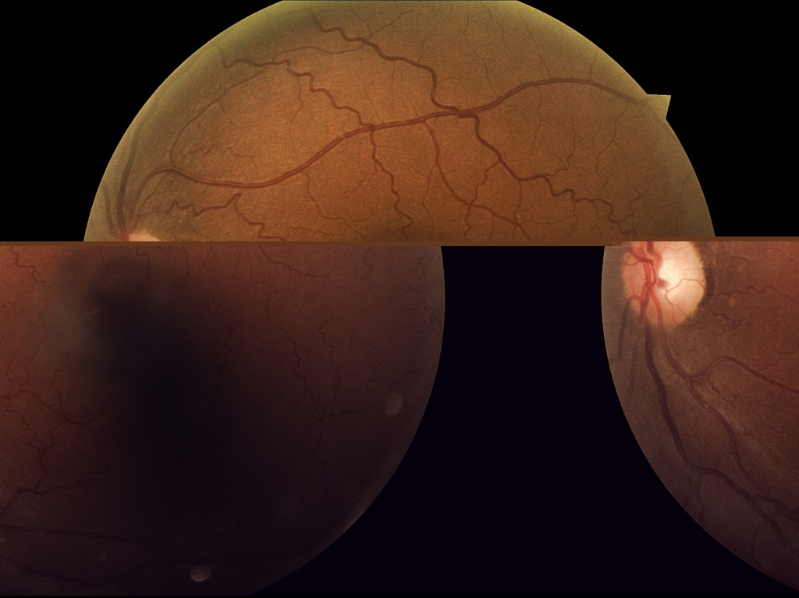
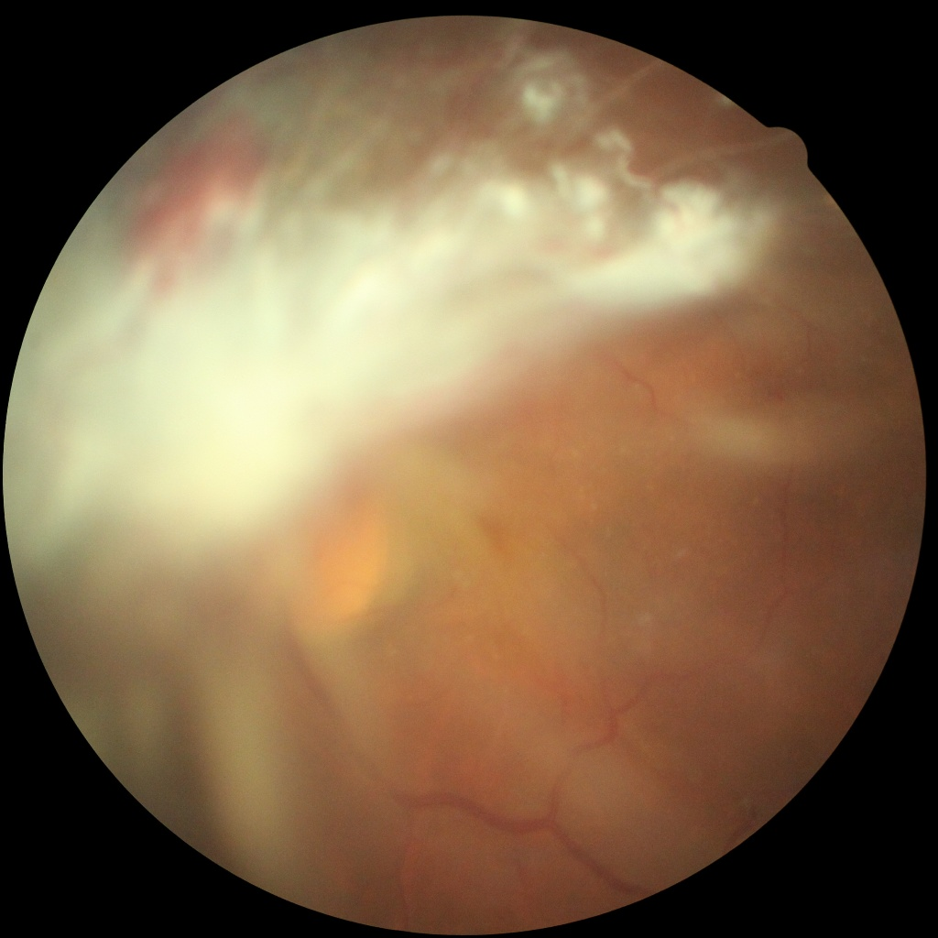
Data Refinement
Dark and Bright Images
Destroyed Images

Slide 15
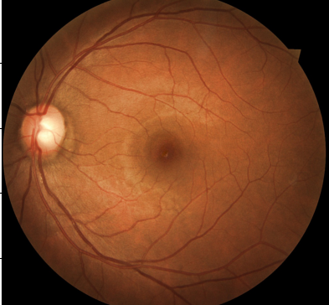
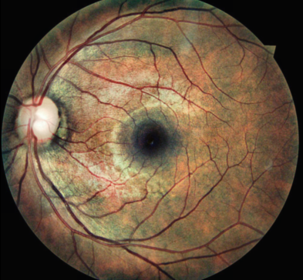
Image Enhancement
Normalization
CLAHE equalization
Gaussian Blur
Morphological Cleaning
Resizing
Before
After

Slide 16
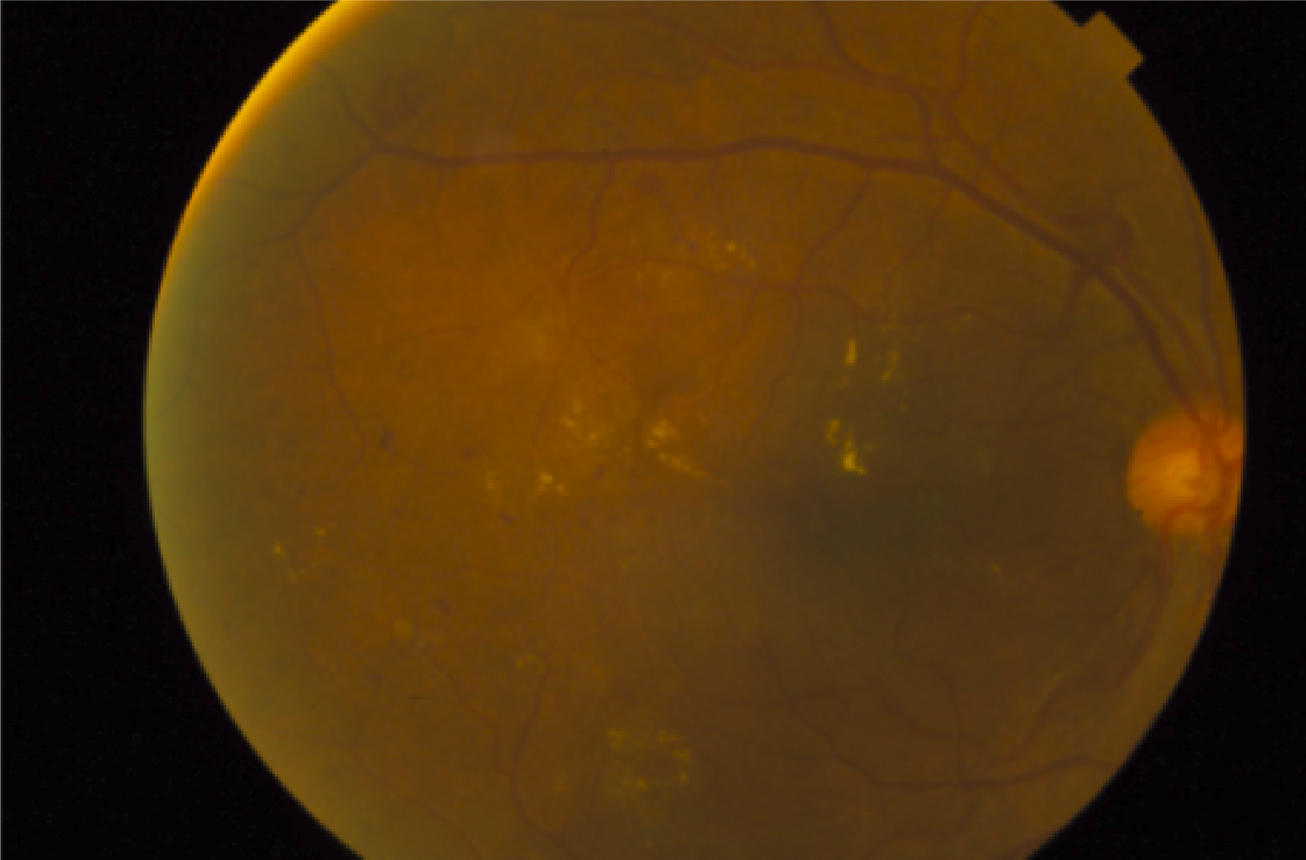
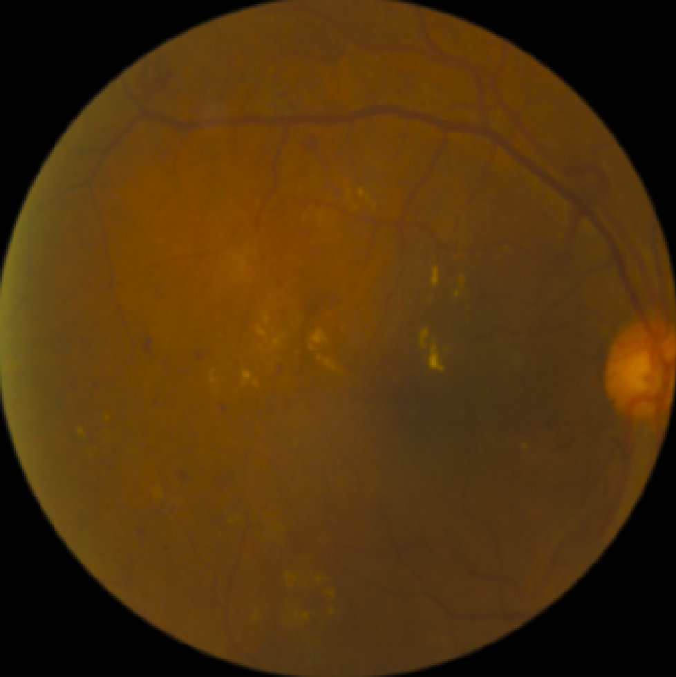
Circle Cropping
Black area is considered as an outlier
Before
After

Slide 17
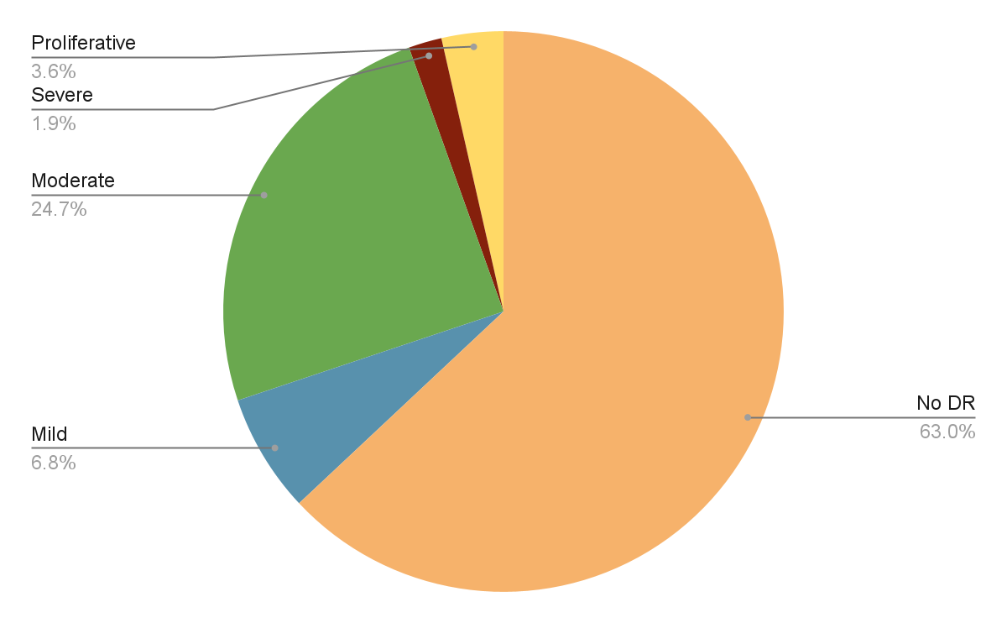
Data Imbalance

Slide 18

Data Augmentation
Traditional Augmentation Techniques
Horizontal flip
Rotation
Width and height shift
Zoom
Augmentation using Morphological Filters
Erosion
Dilation
Opening
Closing

Slide 19
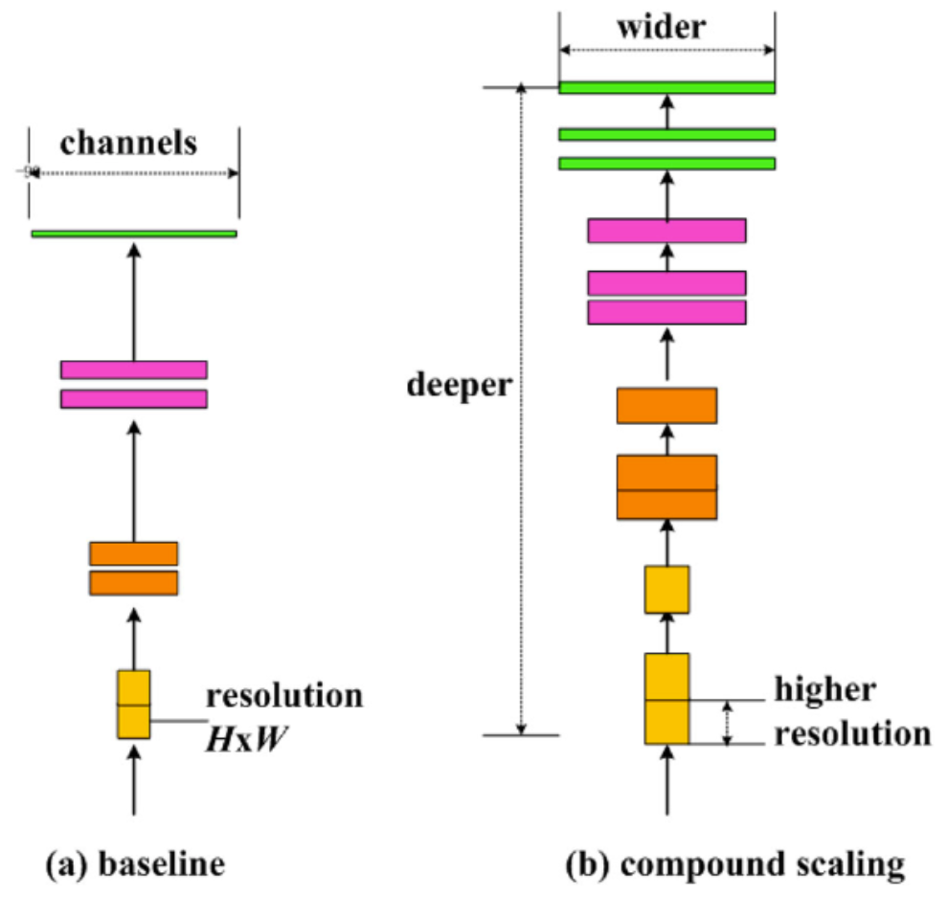
EfficientNetB1
It is based on the compound scaling method that optimizes depth, width, and resolution to achieve better accuracy and efficiency trade-offs.
It has a relatively compact size compared to larger models, with approximately 7.8 million parameters.
It was trained on ImageNet dataset and it accepts an input shape of (224, 224, 3)

Slide 20
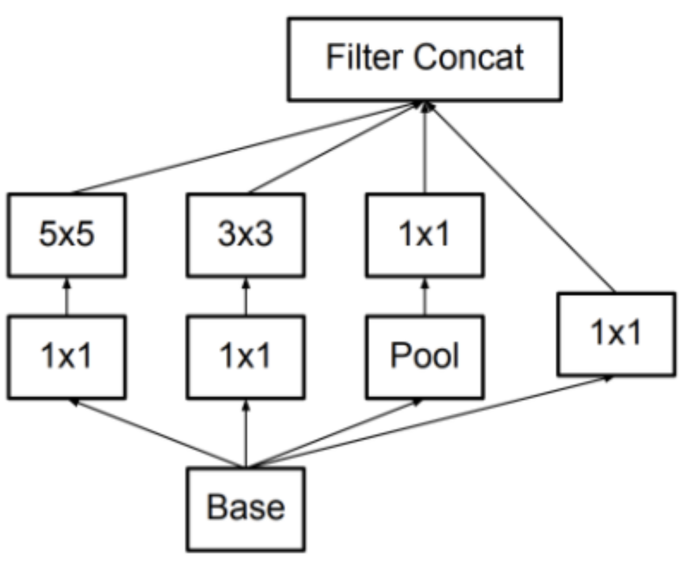
InceptionV3
It is a relatively large model with approximately 23 million trainable parameters.
It consists of multiple Inception modules, which are designed to capture multi-scale features using a combination of 1x1, 3x3, and 5x5 convolutions and max pooling operations.
It incorporates factorization and dimensionality reduction techniques, to improve computational efficiency while maintaining performance.

Slide 21
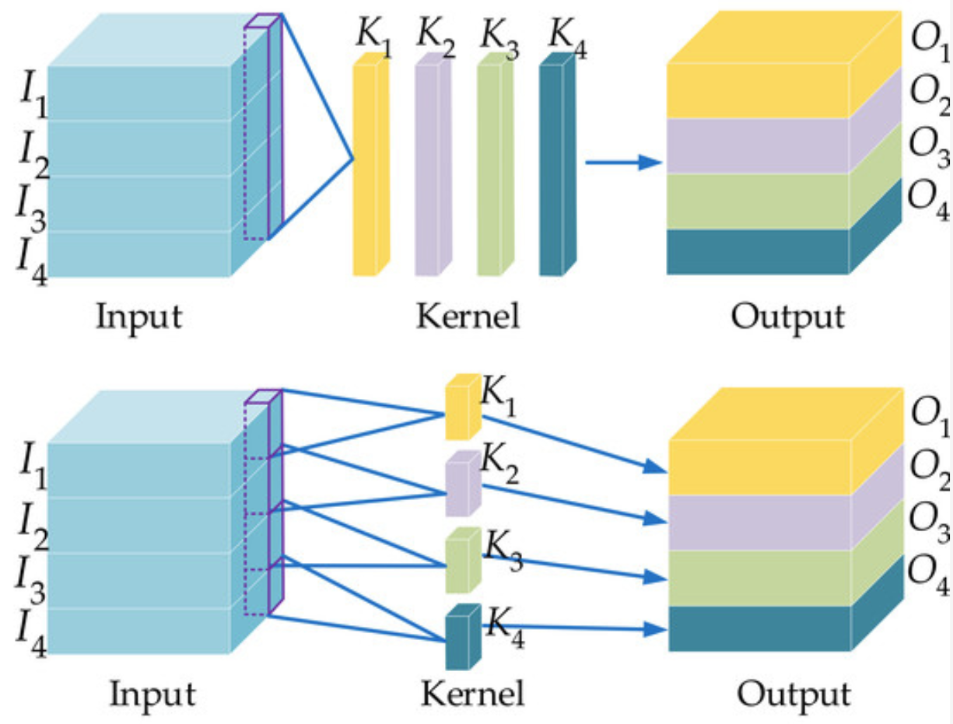
Xception
It is a relatively large model with approximately 22 million trainable parameters.
It introduces depthwise separable convolutions, which decouple spatial and channel-wise convolutions, reducing computational complexity and enhancing the model's ability to capture spatial and channel-wise dependencies.
Xception's design allows it to achieve high accuracy with fewer parameters and computations compared to traditional convolutional neural network architectures.

Slide 22
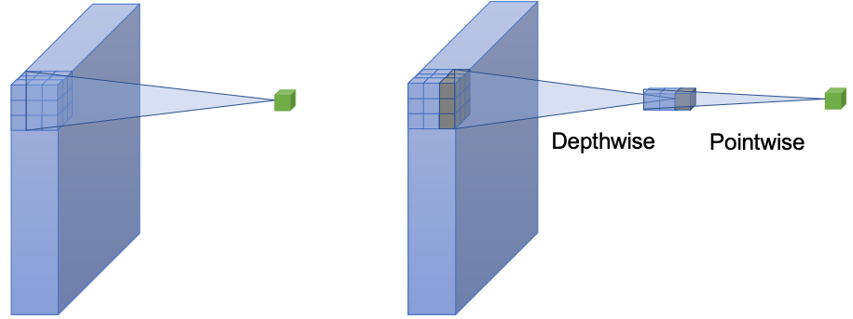
MobileNetV2
It is a lightweight model designed for efficient inference on mobile and embedded devices, with a small memory footprint and approximately 3.4 million trainable parameters.
It employs depthwise separable convolutions, which split the standard convolution operation into a depthwise convolution and a pointwise convolution, significantly reducing the computational cost and model size.

Slide 23
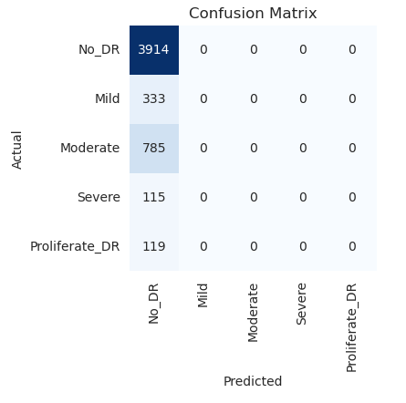
Phase 1: Initial Training using AlexNet & Vgg16
The model failed to classify the DR stages, and only detected the majority class (No_DR).

Slide 24
Phase 2: Experiments on EfficientNetB1
Model Summary
Input
(224, 224, 3)
Base Model
Dense
Units = 128
Batch Normalization
Dropout
Rate = 0.5
Dense
Units = 256
Dense
Units = 5, softmax
Dropout
Rate = 0.4

Slide 25
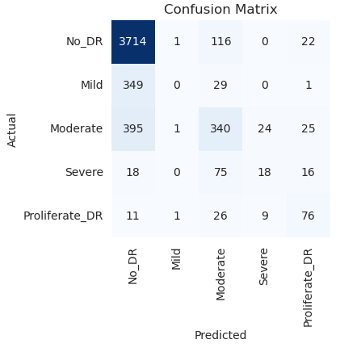
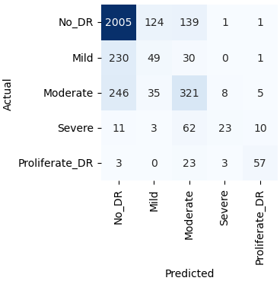
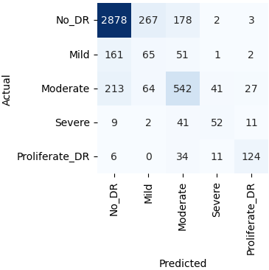
Phase 2: Experiments on EfficientNetB1
Raw EyePACS
Refined EyePACS
Combined Dataset
80.15%
Accuracy on test set

Slide 26
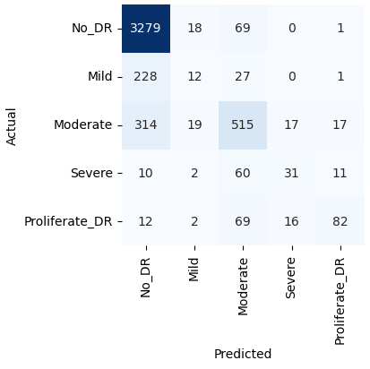
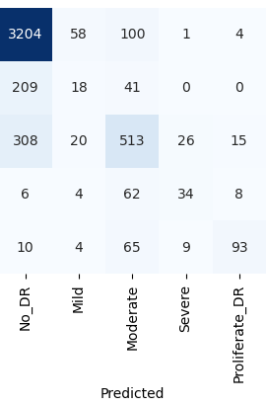
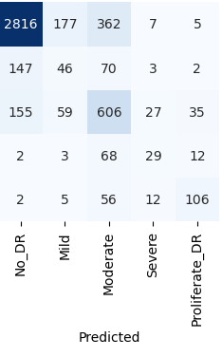
Phase 3: Transfer Learning
InceptionV3
Xception
MobileNetV2

Slide 27
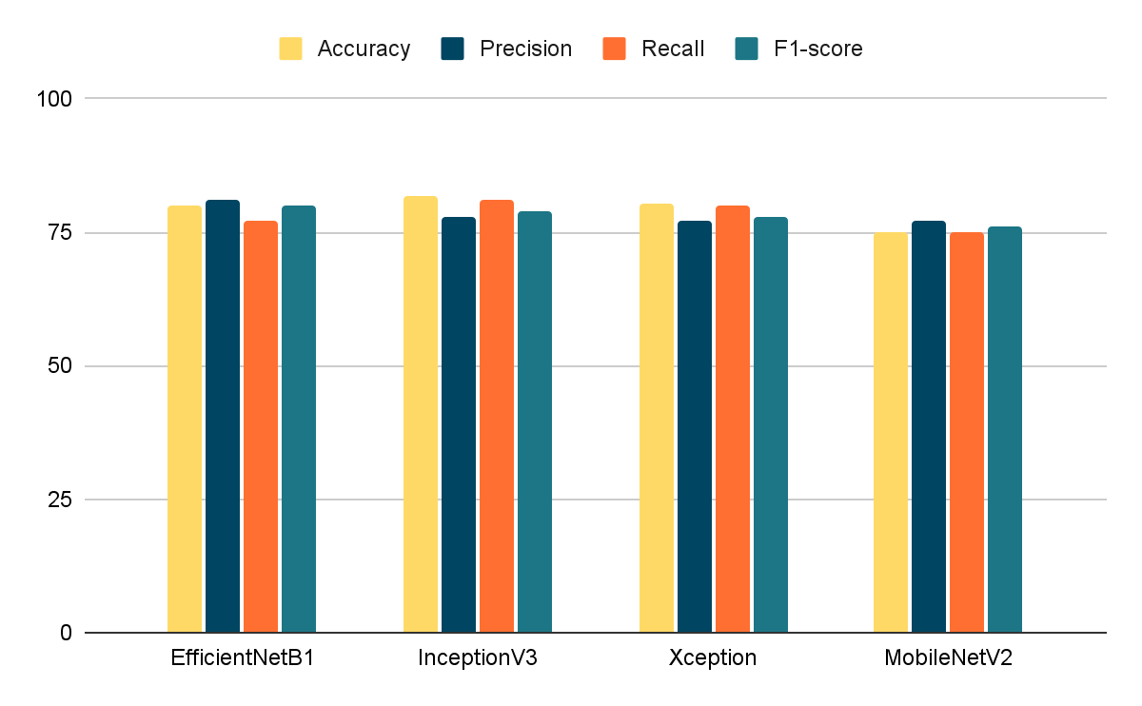
Summary of Results

Slide 28
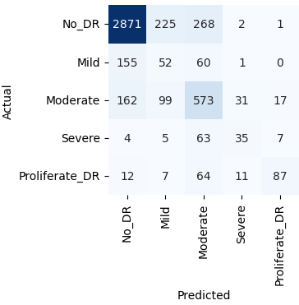
Phase 4: Applying Morphological Filters
With InceptionV3
Before
After

Slide 29
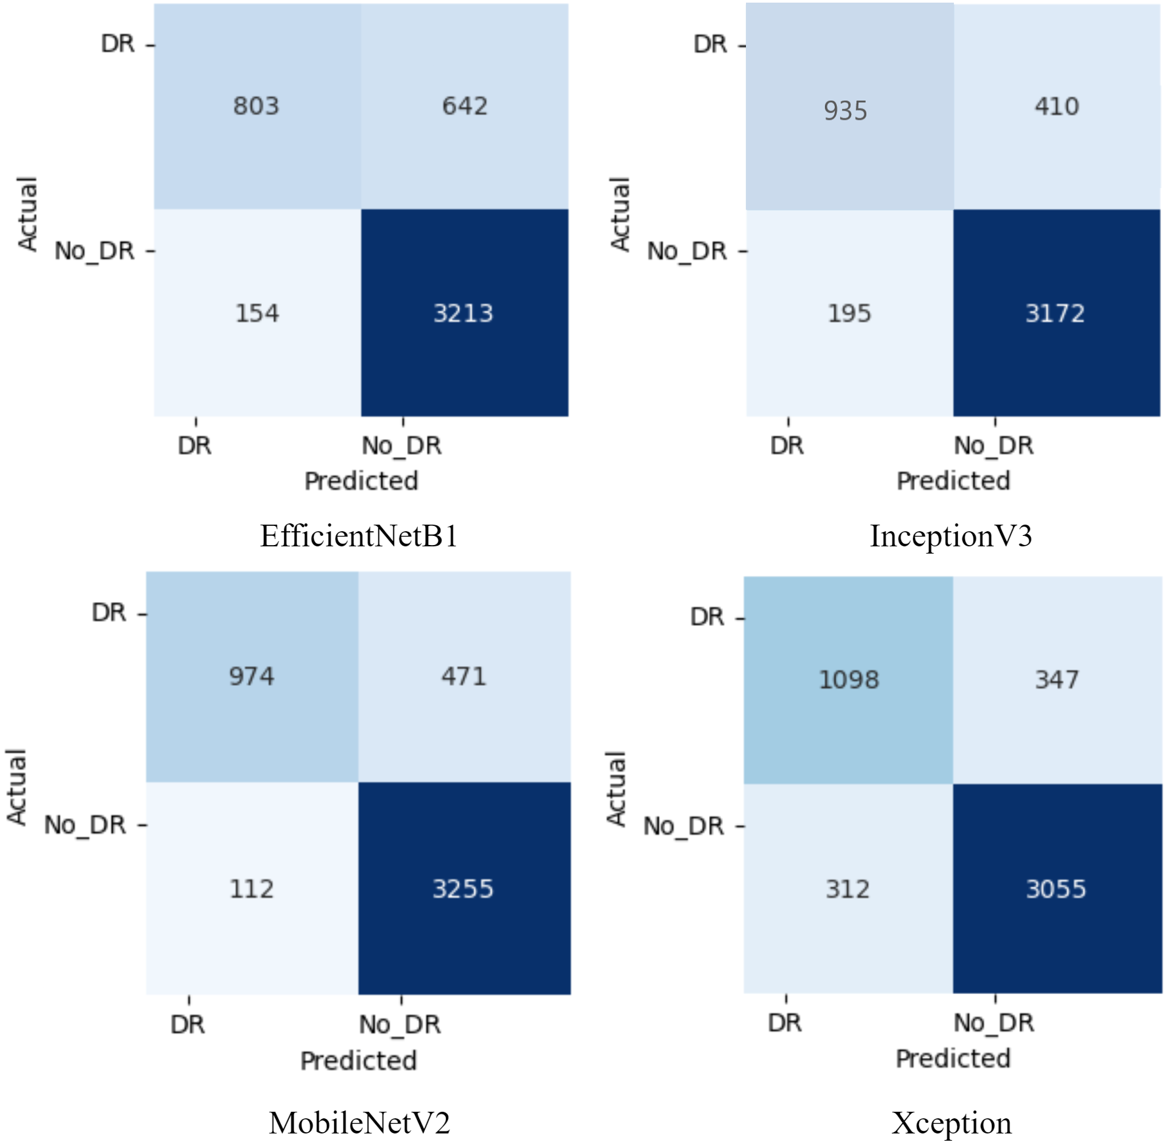
Phase 5: Binary Classification
87.88%
Accuracy on test set using MobileNetV2

Slide 30
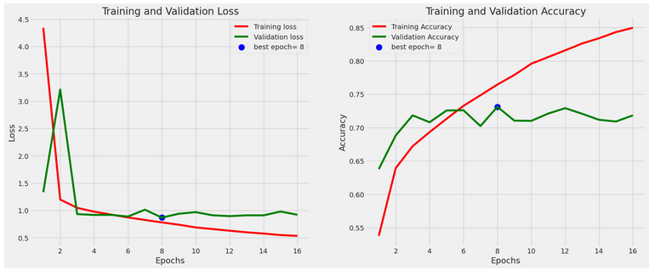
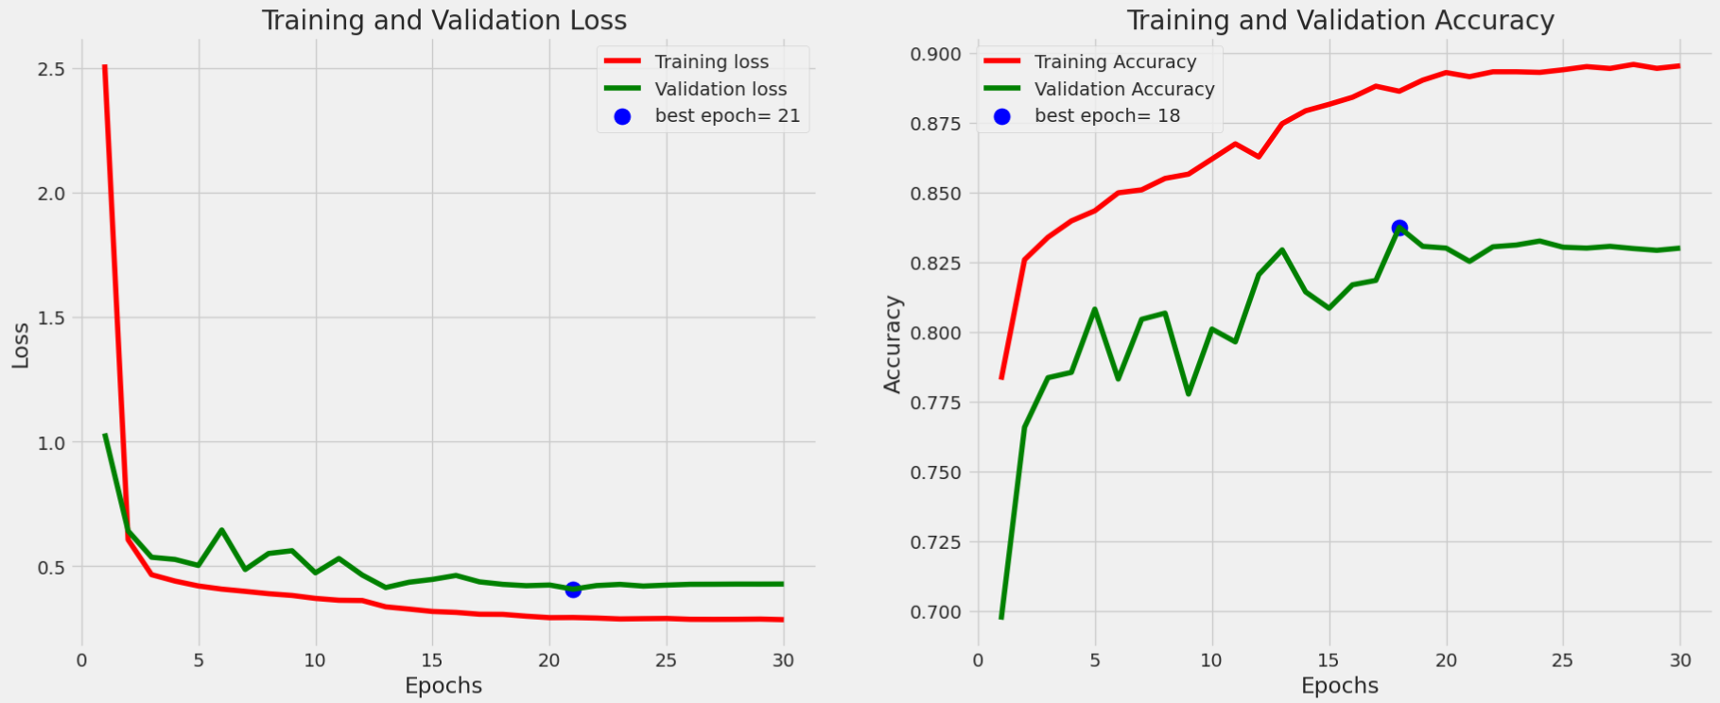
Phase 5: Binary Classification
Binary Classification
5-Class Classification

Slide 31
Summary of Related Work
 | Architecture | Accuracy | Precision | Recall | F1-score
Other works | EfficientNetB1 | 78% | 0.69 | 0.83 | 0.78
 | EfficientNetB3 | 85% | 0.85 | 0.72 | 0.84
 | InceptionV3 | 80% | 0.76 | 0.80 | 0.77
Our Work | EfficientNetB1 | 80.15% | 0.81 | 0.77 | 0.80
 | InceptionV3 | 81.65% | 0.78 | 0.81 | 0.79

Slide 32
Key Accomplishments
leveraged the potential of morphological filters
Improved the classification of the early stages
Explored promising preprocessing techniques

Slide 33
Challenges
Data imbalance, small representation of some classes
Overfitting and plateau phenomenon
High feature similarity of No_dr and Mild stages
Limited computational resources like GPU

Slide 34
Future work
Explore the capability of morphological filers in data augmentation by using different operations and varying structuring elements.
Expand the dataset to encompass diverse populations and improve transfer learning models.
Incorporate additional evaluation metrics like Quadratic Weighted Kappa and introduce eXplainable AI (XAI) techniques for interpretation.
Develop a user-friendly app integrating deep learning models for real-time analysis of retinal images, revolutionizing DR diagnosis and monitoring.

Slide 35
The End!
Thank you for your attendance!

